Slide 1

“To-Do List”
Task - 2

Slide 2
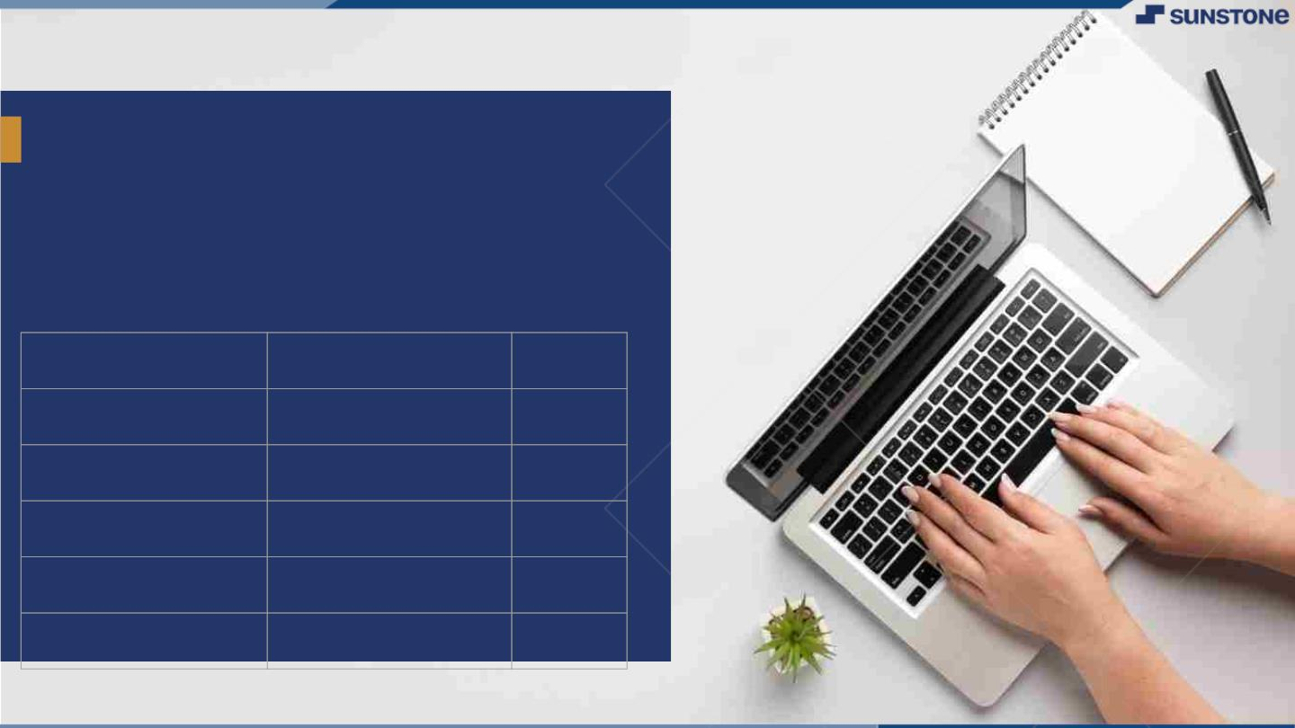
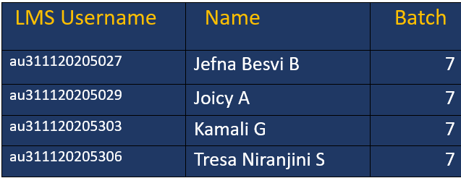
To-Do List
▪
A to-do list serves as the cornerstone for organized execution. It acts as a dynamic roadmap, guiding the team through tasks, deadlines, and priorities.
LMS Username
Name
Batch

Slide 3
Task-2
Create UI and implement various components using react
Split design into components and Higher order Components
Define structure of the components
Set the basic ui components with dummy data
Integrate the APIs to frontend to ensure the dynamic feature of website
Point base api to the severs base url
Design api calls for each element
Handle errors in the output
Render output of apis to different low level components
Secure content of post apisx
Evaluation Metric
100% Completion of the above tasks
Learning Outcome
Developing complicated UI using react components
Using props drilling and context to pass variables
Getting familiar with different type of api calls
Handling different input data

Slide 4

Step-Wise Description
Establish a well-organized component hierarchy by splitting major UI elements into smaller, reusable components, including the use of Higher Order Components (HOCs) for shared logic and state.
Design and implement functions for diverse API calls (GET, POST) with robust error handling.
Implement secure practices, such as HTTPS and encryption, when posting data to APIs to safeguard sensitive information.
Summary of Task2
Develop a dynamic React app with a structured component hierarchy.
Integrate APIs for real-time data, handling diverse API calls securely..
Gain valuable experience in React component development, props management, and advanced API integration.

Slide 5

Assessment Parameter
Setup project for the “To-Do-list project
Setup basic structure of text-Editor project
Create a main component with the Outer structure of To-Do-List
Check-List
Create main component with
All features
Create a button component With on click handler
Create a json object to store
Data for text editor
Create a evaluate Expresion
Function to evaluate value
Push your changes to github

Slide 6

Submission Github
https://github.com/JefnaBesvi/NM-LICET-IT-GROUP-7

Slide 7


